Slide 1
“AeroplaneWars‘’
Featuring: Aircraft Battle Game
ELEC5566M Group 19

Slide 2
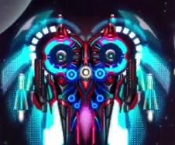

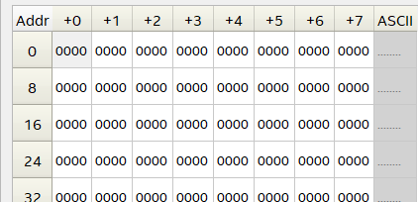
LCD Display

Slide 3
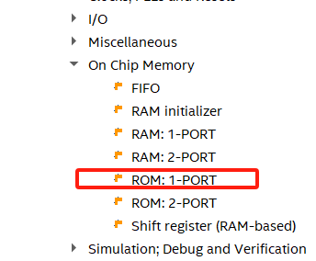
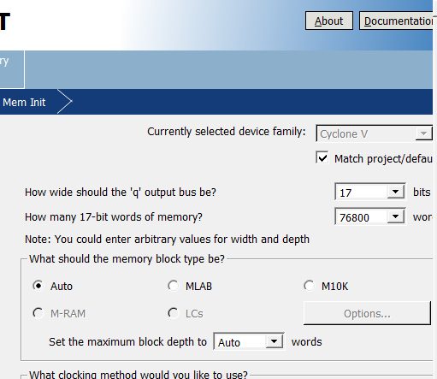
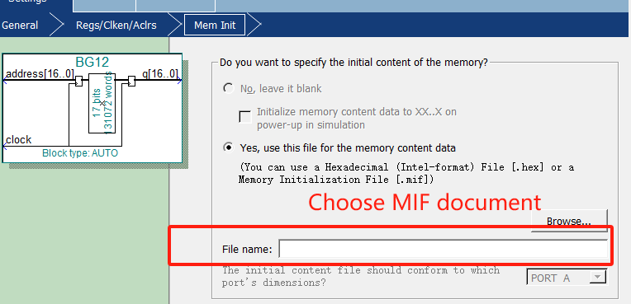
Create IP Core

Slide 4
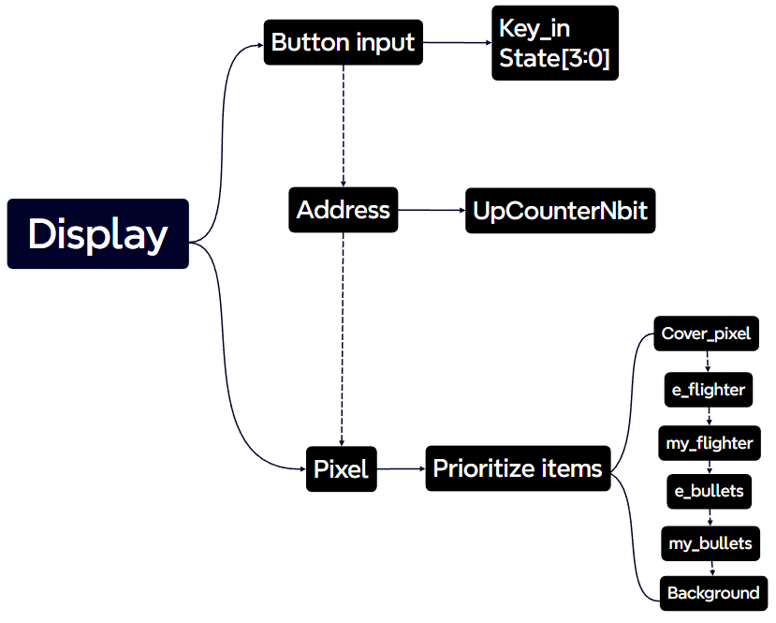
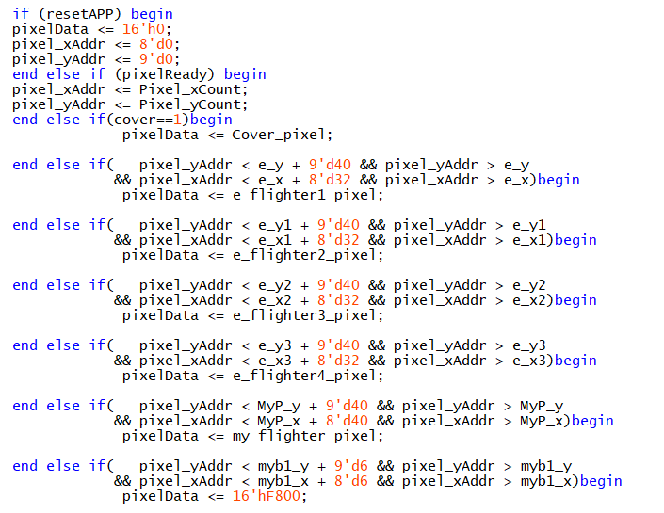
The Priority of Display

Slide 5
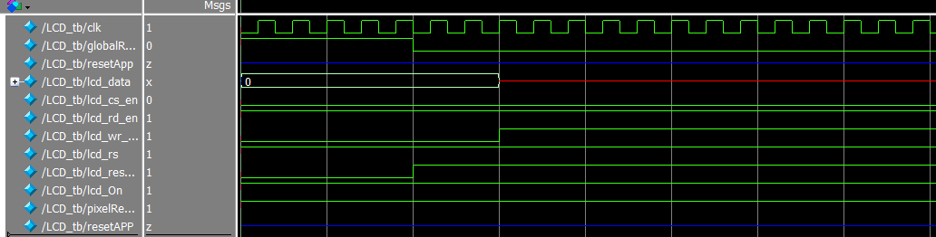
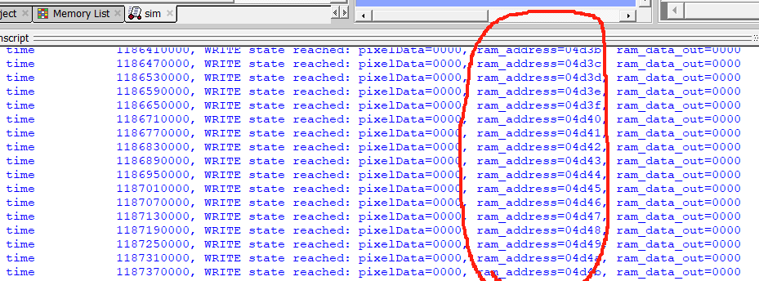
Debug

Slide 6
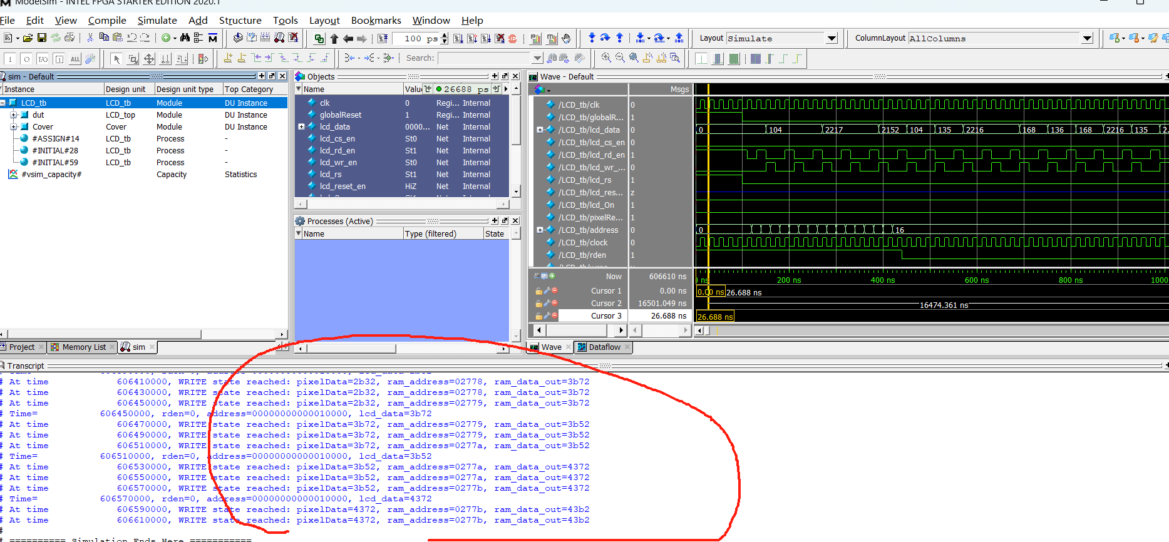

Slide 7
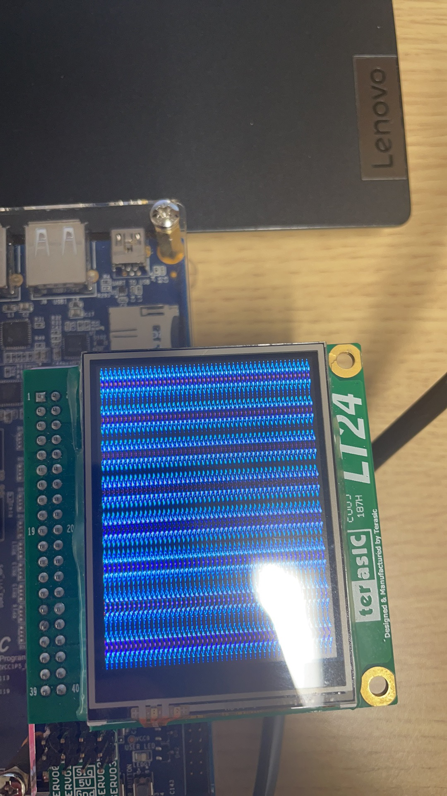
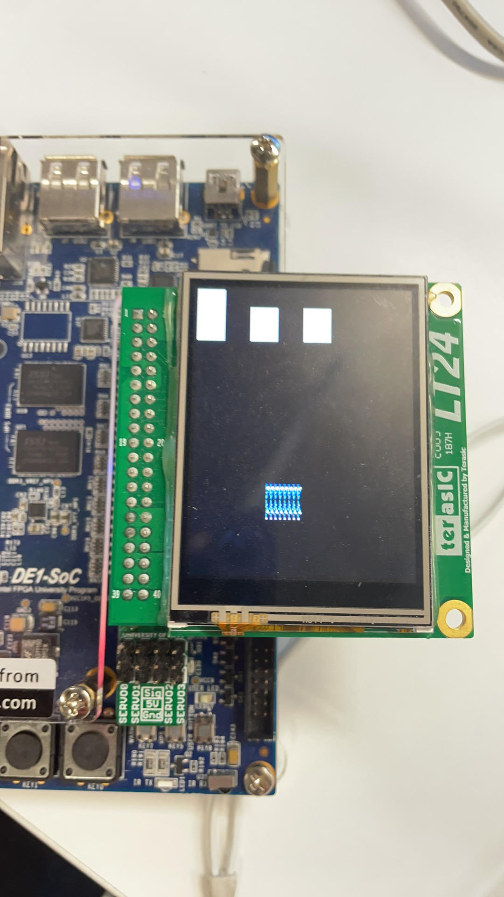
Debug

Slide 8
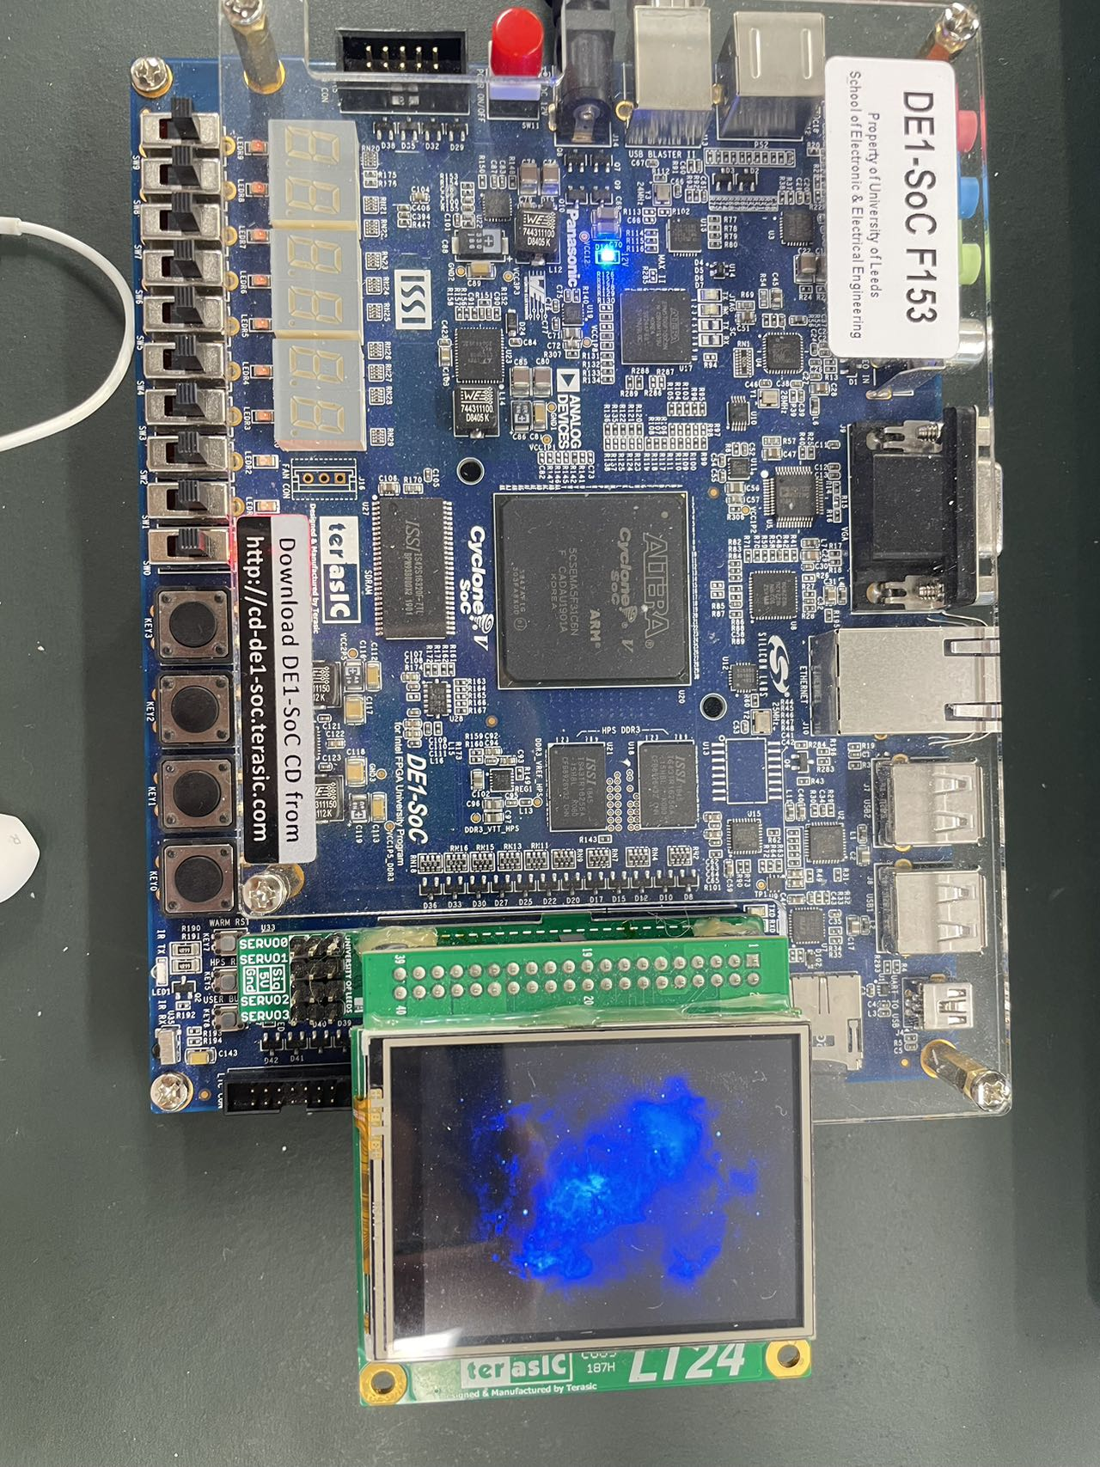
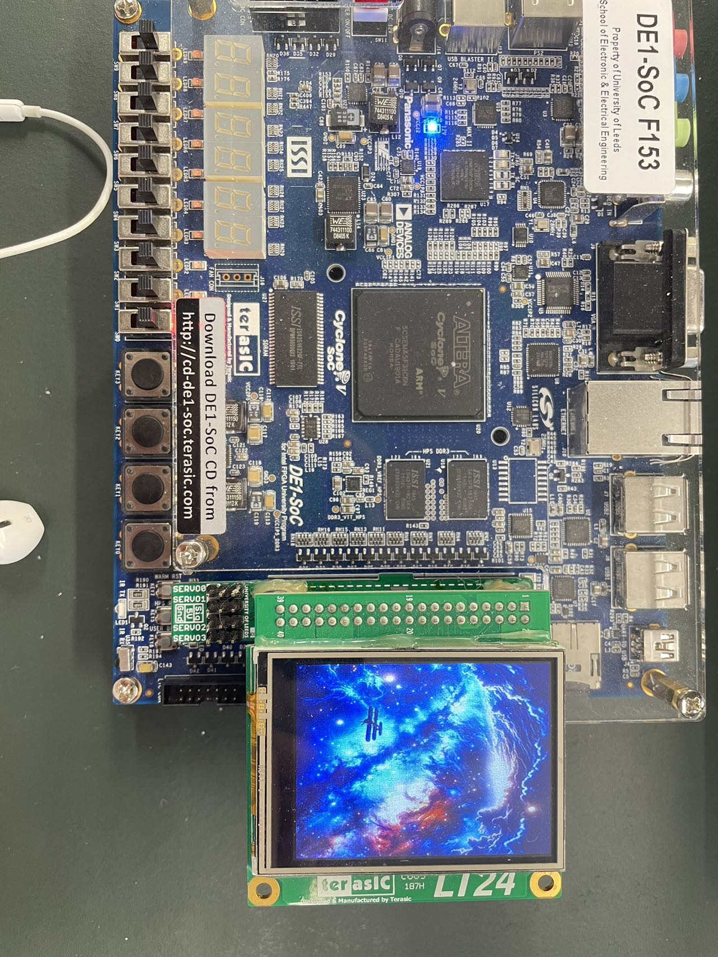
Result of display

Slide 9
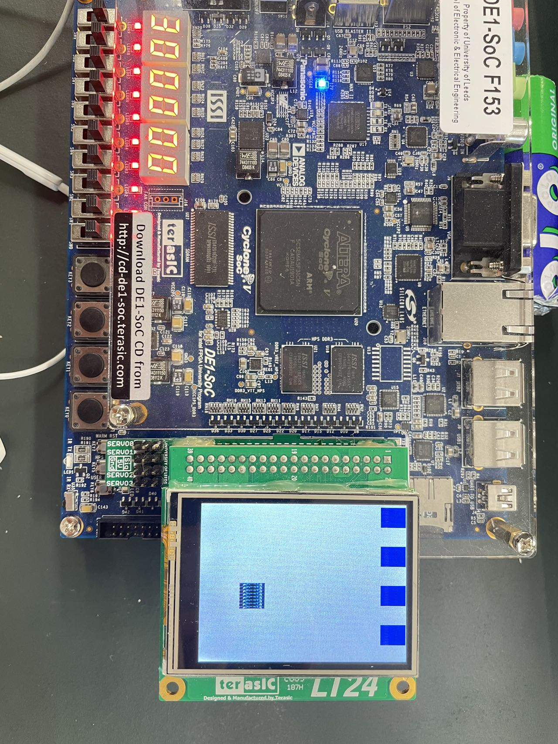
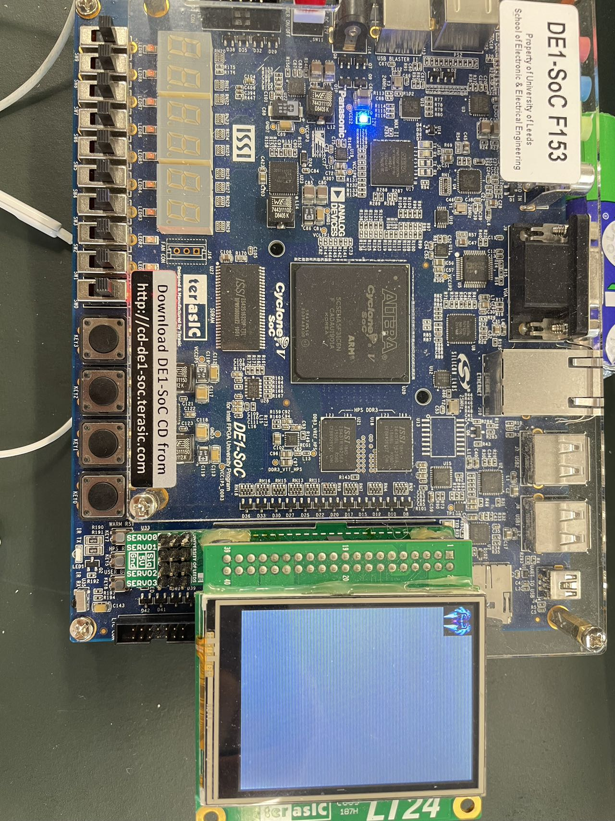
Result of display

Slide 10
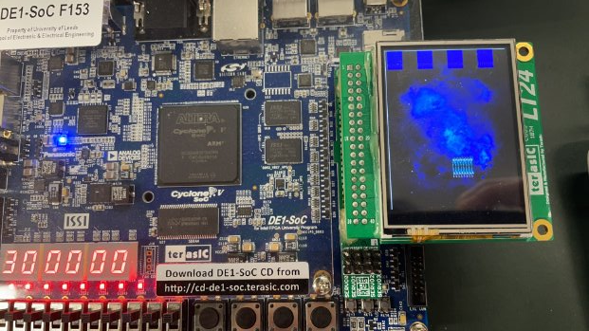
Result of display

Slide 11
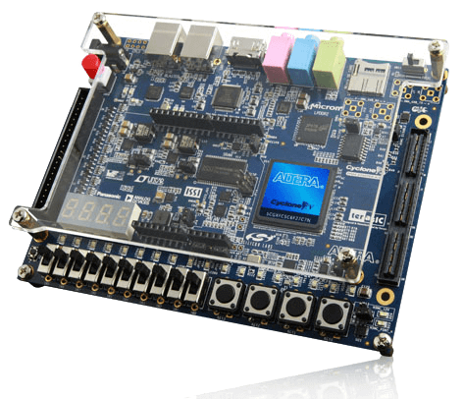
Switch and Segment Device
Switch module
Segment device
Notes:
I was responsible for the core logic and integration of the main parts of the project. Our design methodology involved developing several key modules to ensure smooth and responsive gameplay. The most critical modules are the Hit module, Crash module, and Main Control module.

Slide 12
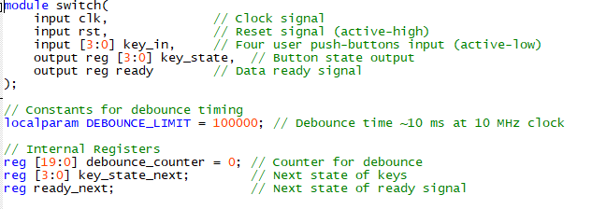
Switch Module
Function
The four keys (key0, key1, key2, key3) control the movement of the of the aircraft
Input and Output Signal
Inputs (clk, rst, key_in)
Outputs (key_state, ready)
The clock runs for 5000 cycles.
Notes:
The Hit Module is responsible for detecting if an enemy bullet hits our aircraft. It takes the coordinates of both the bullet and the aircraft as inputs. If the bullet's coordinates fall within the boundaries of the aircraft, the module outputs a signal indicating a hit.
The algorithm ensures fast and accurate detection, avoiding false collisions by excluding certain areas. This module is crucial for maintaining realistic gameplay dynamics."

Slide 13
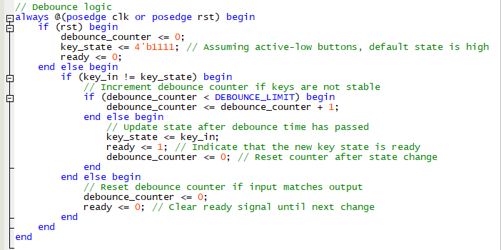
Switch Module
Debounce logic
Check ：If the key state remains unchanged during the de-bounce time, the key state is considered to be stable, and the corresponding key state and data ready signal are output.
Notes:
The Hit Module is responsible for detecting if an enemy bullet hits our aircraft. It takes the coordinates of both the bullet and the aircraft as inputs. If the bullet's coordinates fall within the boundaries of the aircraft, the module outputs a signal indicating a hit.
The algorithm ensures fast and accurate detection, avoiding false collisions by excluding certain areas. This module is crucial for maintaining realistic gameplay dynamics."

Slide 14
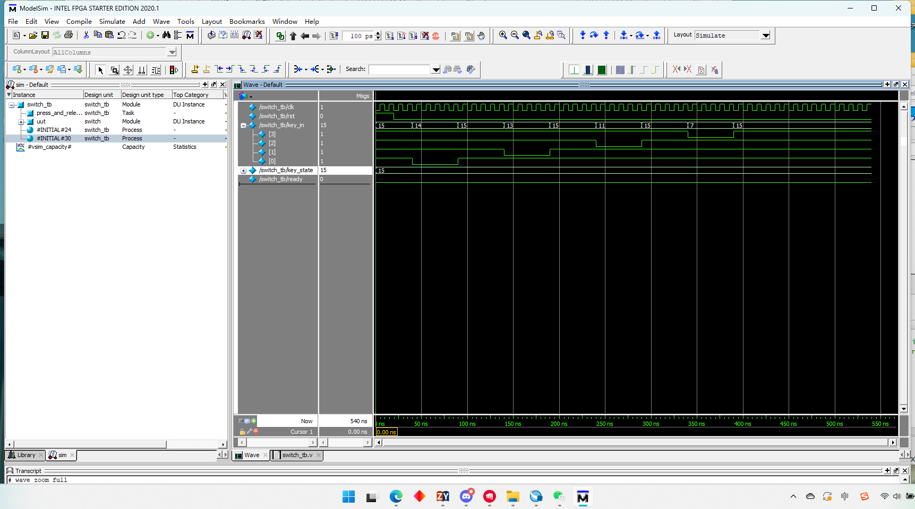
Test bench
the clock signal is a standard square wave with a period of 10 ns.
At the beginning, the reset signal is set high (1) for 20 nanoseconds to ensure that the system starts from a known state.
It is then set low (0) to allow the system to operate normally. The key input is pressed and released sequentially starting from key0 to key3.
Notes:
The Hit Module is responsible for detecting if an enemy bullet hits our aircraft. It takes the coordinates of both the bullet and the aircraft as inputs. If the bullet's coordinates fall within the boundaries of the aircraft, the module outputs a signal indicating a hit.
The algorithm ensures fast and accurate detection, avoiding false collisions by excluding certain areas. This module is crucial for maintaining realistic gameplay dynamics."

Slide 15
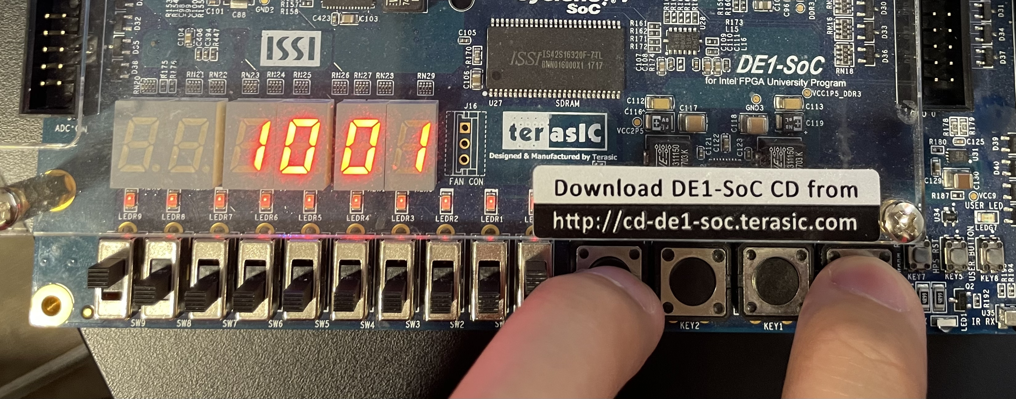
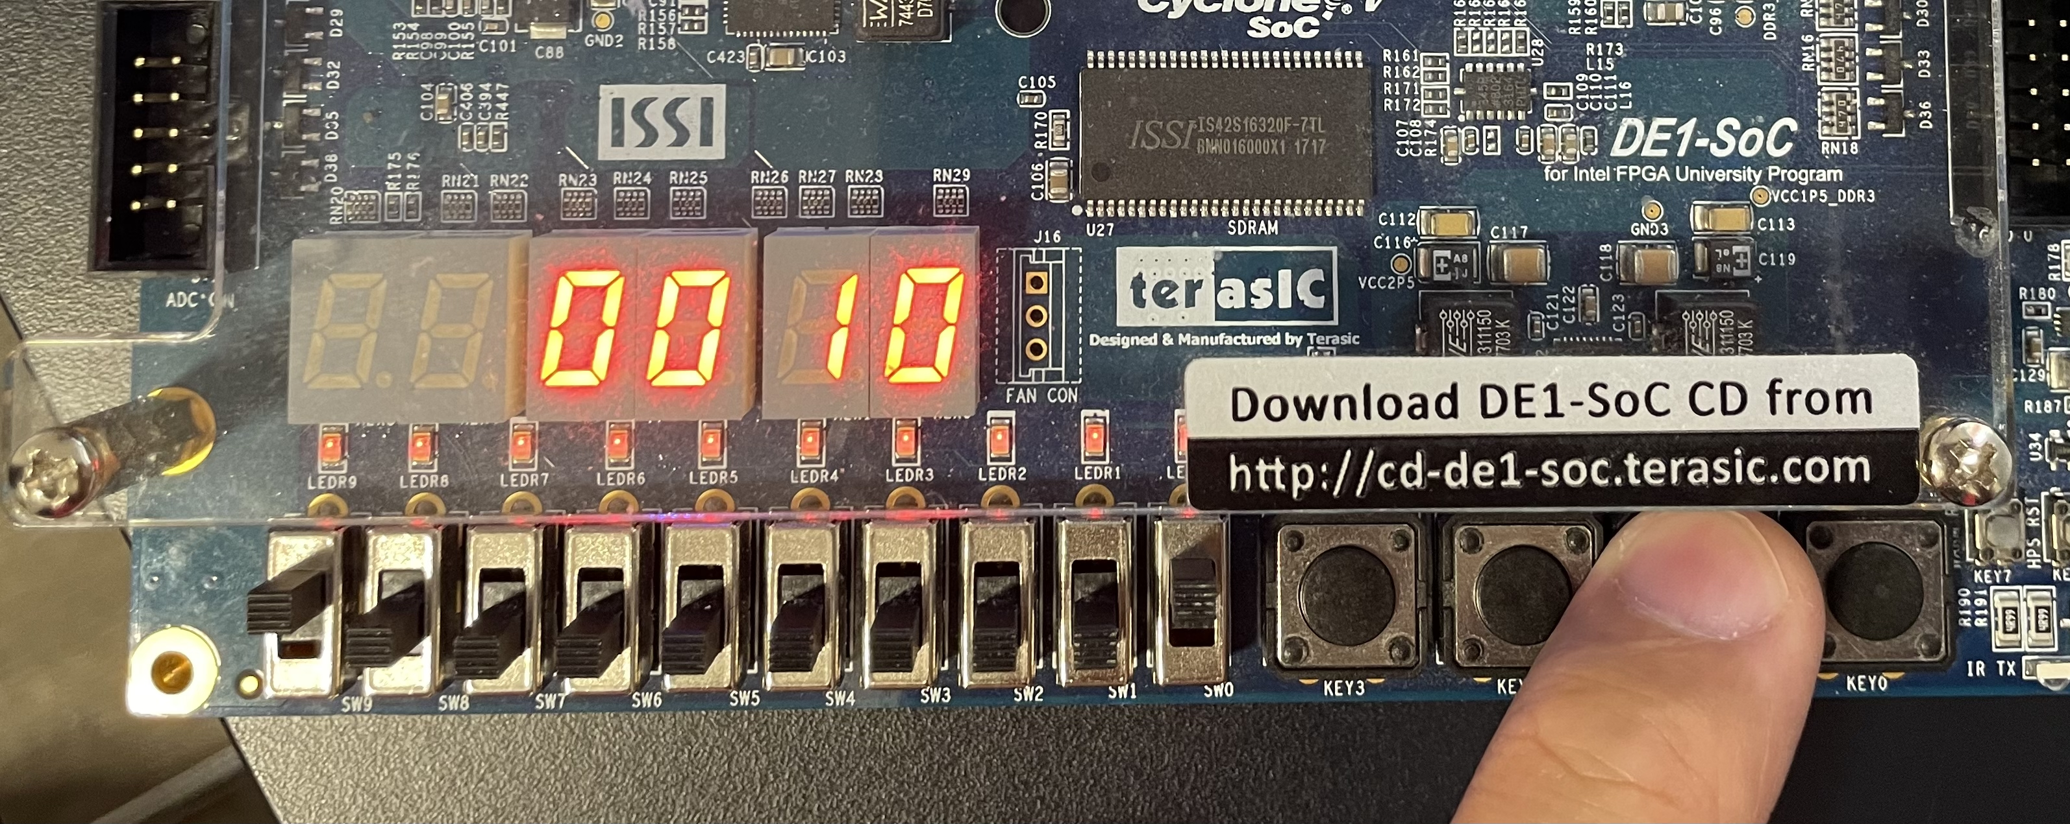
Result
Notes:
The Hit Module is responsible for detecting if an enemy bullet hits our aircraft. It takes the coordinates of both the bullet and the aircraft as inputs. If the bullet's coordinates fall within the boundaries of the aircraft, the module outputs a signal indicating a hit.
The algorithm ensures fast and accurate detection, avoiding false collisions by excluding certain areas. This module is crucial for maintaining realistic gameplay dynamics."

Slide 16
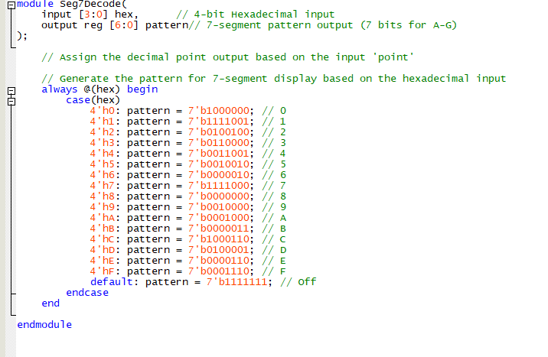
Segment Device
Function
use 6 seven-segment digital tubes on the development board to display the player's game scores
Refer to UNIT 1-2-7-segment
Notes:
The Hit Module is responsible for detecting if an enemy bullet hits our aircraft. It takes the coordinates of both the bullet and the aircraft as inputs. If the bullet's coordinates fall within the boundaries of the aircraft, the module outputs a signal indicating a hit.
The algorithm ensures fast and accurate detection, avoiding false collisions by excluding certain areas. This module is crucial for maintaining realistic gameplay dynamics."

Slide 17
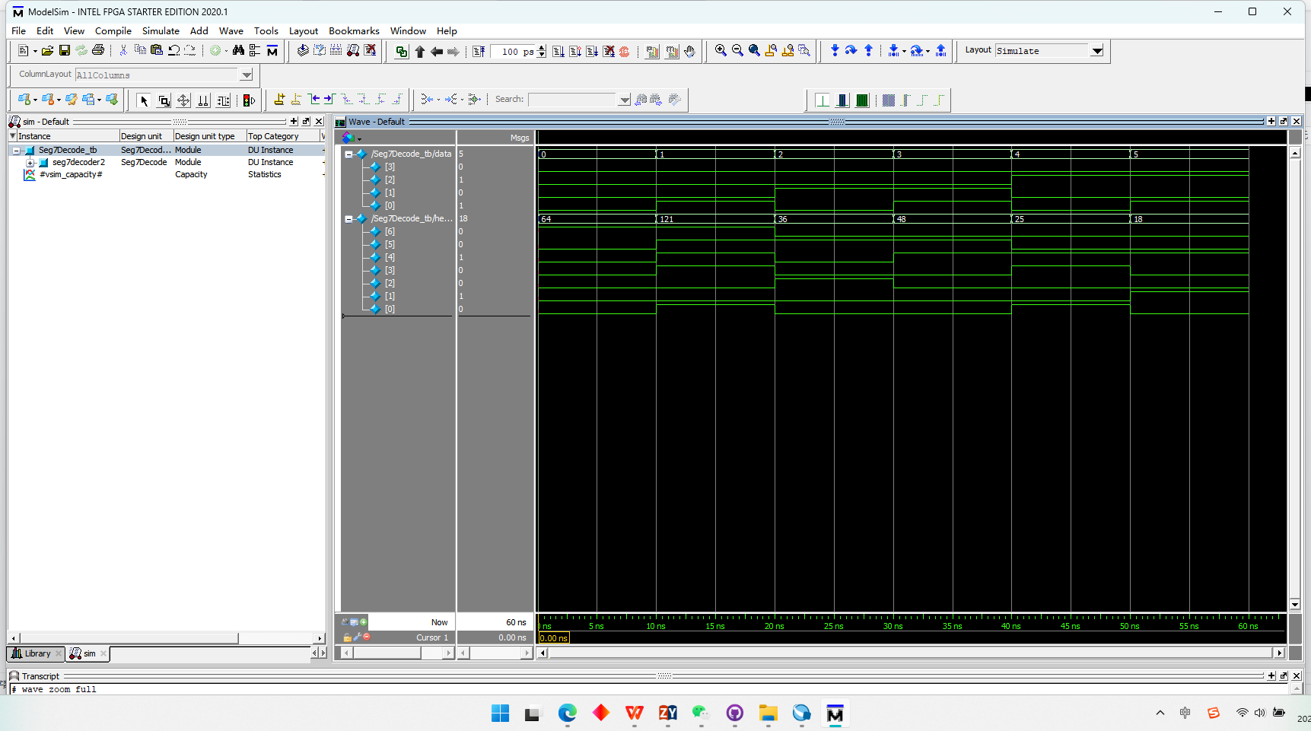
Test bench
In Seg7Decode_tb, data is a 4-bit binary input, varying from 0 to 5, with each value lasting 10 nanoseconds.
hex_pattern2 is a 7-bit binary output indicating whether each segment of the seven-segment display is lit.
Notes:
The Hit Module is responsible for detecting if an enemy bullet hits our aircraft. It takes the coordinates of both the bullet and the aircraft as inputs. If the bullet's coordinates fall within the boundaries of the aircraft, the module outputs a signal indicating a hit.
The algorithm ensures fast and accurate detection, avoiding false collisions by excluding certain areas. This module is crucial for maintaining realistic gameplay dynamics."

Slide 18
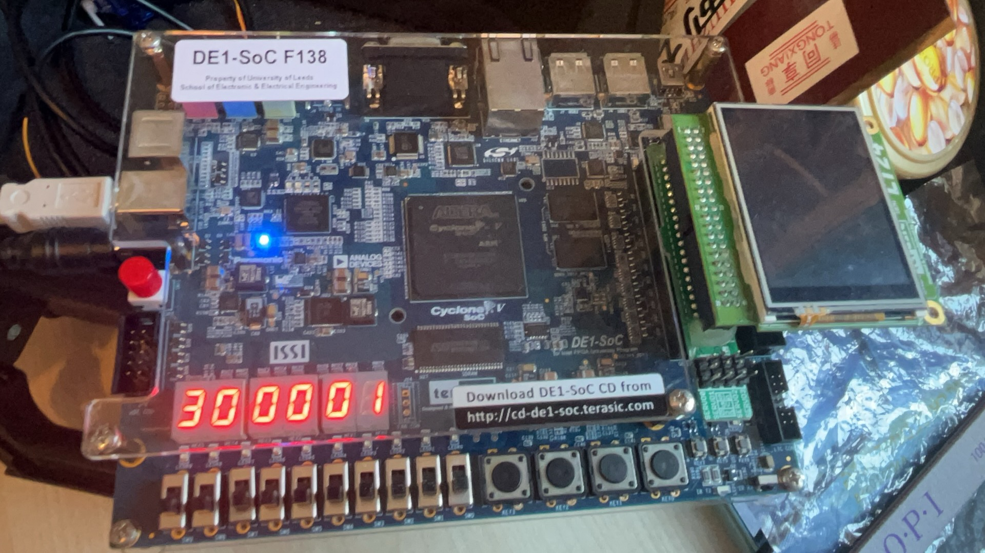
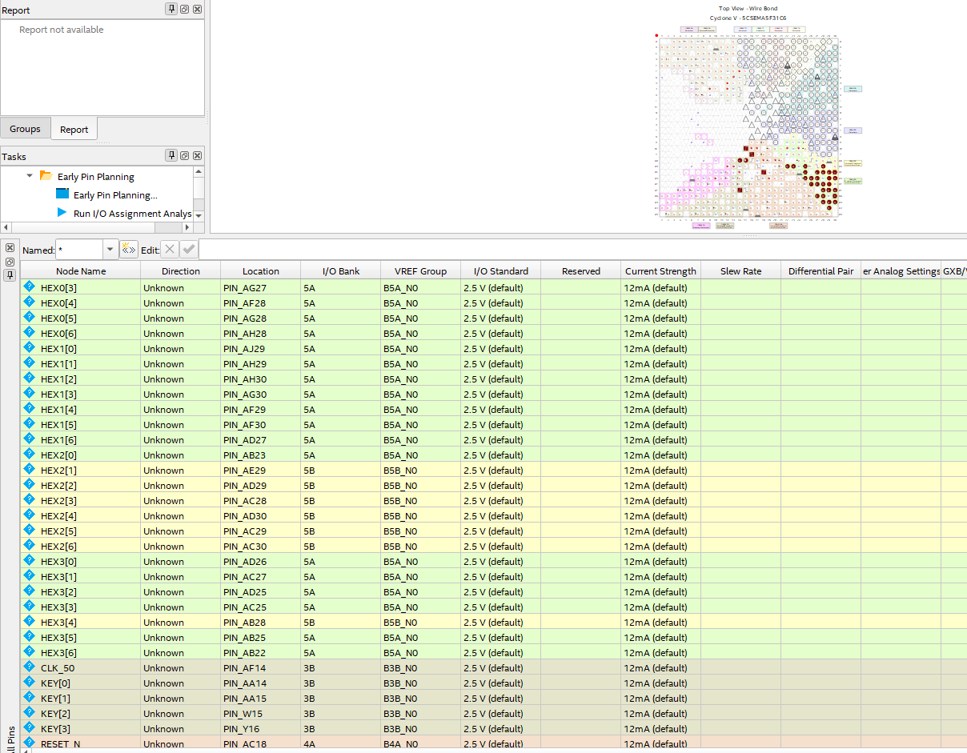
Result
Notes:
The Hit Module is responsible for detecting if an enemy bullet hits our aircraft. It takes the coordinates of both the bullet and the aircraft as inputs. If the bullet's coordinates fall within the boundaries of the aircraft, the module outputs a signal indicating a hit.
The algorithm ensures fast and accurate detection, avoiding false collisions by excluding certain areas. This module is crucial for maintaining realistic gameplay dynamics."

Slide 19

Logic Module
Hit module
Crash module
Main Control module
Notes:
I was responsible for the core logic and integration of the main parts of the project. The most critical modules are the Hit module, Crash module, and Main Control module.

Slide 20
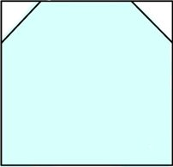
Logic Module-Hit
Input Coordinates:
es_x and es_y: The x and y coordinates of the enemy bullet.
ms_x and ms_y: The x and y coordinates of our aircraft.
Output Signal:
check: A high-level signal that indicates a hit if the bullet coordinates fall within the boundaries of our aircraft.
Algorithm: Fast and accurate collision detection, excludes false collisions.
Notes:
The Hit Module is responsible for detecting if an enemy bullet hits our aircraft. It takes the coordinates of both the bullet and the aircraft as inputs. If the bullet's coordinates fall within the boundaries of the aircraft, the module outputs a signal indicating a hit.
The algorithm ensures fast and accurate detection, avoiding false collisions by excluding certain areas. This module is crucial for maintaining realistic gameplay dynamics."

Slide 21
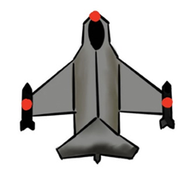
Logic Module-Crash
The Crash Module detects if our aircraft collides with an enemy aircraft. It compares the coordinates of both aircraft, and if any part of an enemy aircraft enters our aircraft's boundaries, the module outputs a signal indicating a crash.
Inputs: Enemy aircraft (e_x, e_y) and Our aircraft (mi_x, mi_y) coordinates.
Output: check signal indicating a crash.
Algorithm: Calculates complex spatial relationships to ensure accurate and real-time collision detection.
Notes:
The Crash Module is responsible for detecting if our aircraft collides with an enemy aircraft. It takes the coordinates of both the enemy aircraft and our aircraft as inputs. If any part of the enemy aircraft enters the boundaries of our aircraft, the module outputs a signal indicating a crash.
The algorithm used calculates complex spatial relationships to ensure accurate detection. It identifies critical points like the front, back, and wingtips of the enemy aircraft to check for collisions.

Slide 22
Logic-main
The Main Module is the central hub of the game, coordinating all sub-modules, handling player inputs, and updating game states.
Inputs: System clock, player controls (switches and buttons).
Outputs: Game state indicators (scores, life values), LCD display, LED indicators.
Responsibilities: Initialize game parameters, update game logic, manage display outputs.
Technical Details: Calls various sub-modules (Hit, Crash), manages game variables (e.g., player coordinates, enemy coordinates), and ensures real-time performance.
Notes:
Now, I'll explain the Main Module.
The Main Module acts as the game's central hub. It coordinates various sub-modules like Hit and Crash, handles player inputs, and manages game states.
It receives inputs such as the system clock and player controls. The module initializes game parameters, updates game logic, and manages display outputs.
Technically, it calls sub-modules to detect collisions and hits. It manages game variables like player and enemy coordinates and ensures real-time performance and smooth gameplay.

Slide 23
Logic Module- Main Module Implementation Details
Key Challenges:
Inconsistent Submodule Interfaces
Complexity in Control Logic
Bug Localization and Fixing
Notes:
Now, I'll discuss the implementation details of the Main Module.
During the development of our FPGA-based flight combat game, we faced several challenges:
Inconsistent Submodule Interfaces: Different interface designs from team members required adjustments for seamless integration.
Complexity in Control Logic: The evolving game rules increased complexity, necessitating careful design to maintain stability and responsiveness.
Bug Localization and Fixing: Integration testing revealed several logical errors and performance bottlenecks, which we addressed through systematic testing and analysis.
These challenges tested our technical skills and deepened our understanding of complex system interactions.

Slide 24
Logic Module- Test Bench and Verification
Unit tests for hit and crash logic.
Integration tests in a complete game environment.
System tests for response time and status updates.
Addressed issues through extensive code review and modifications.
Notes:
To validate the functionality of each key module and ensure system-wide compatibility, I created a detailed testing platform.
Unit Tests: I tested the Hit and Crash modules to verify the accuracy of hit detection and crash logic by simulating various positions of enemy aircraft and bullets.
Integration Tests: I integrated these modules into the Main Control module and conducted comprehensive system tests, simulating a complete game environment to observe module interactions, system response time, and game logic processing.
System Tests: I ensured the system responded instantly to player actions and that game status updates were reflected immediately on the user interface.
Challenges: During testing, incorrect results in simulated waveforms prompted repeated modifications. To address this, I learned and referenced teammates' code extensively and wrote additional test modules for integration testing until the correct results were achieved.
This thorough testing process confirmed the accurate operation and compatibility of all function blocks within the system.

Slide 25
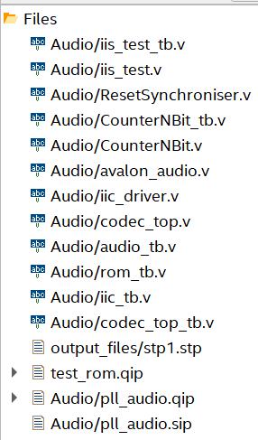
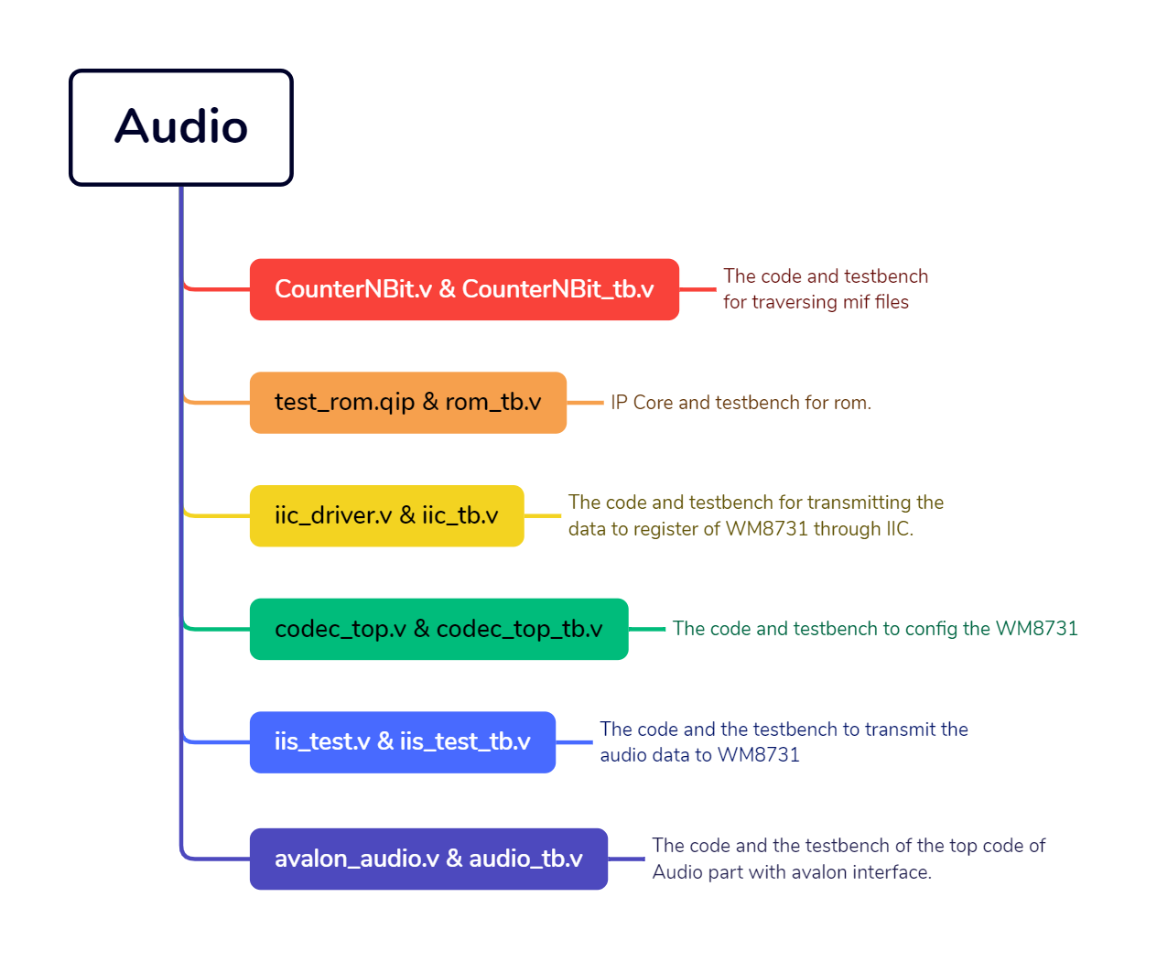
Audio Related File Directory
Notes:
Next, I will explain the code integration and the debug section. First of all, during the process of adjusting the pingpong code to the LCD code, due to the incorrect number of parameters in the LT24, there are many errors that are incorrectly caused by the related driver code update (as shown in the figure below). In the analysis and discussion found in this year‘s update, the LT24 update is mainly to add the context of the data structure LT24CTX_T (as follows). The purpose is to put the LT24 control status and data in the structure. Therefore, the entire LT24 driver can be achieved. More fluent and clear！

Slide 26
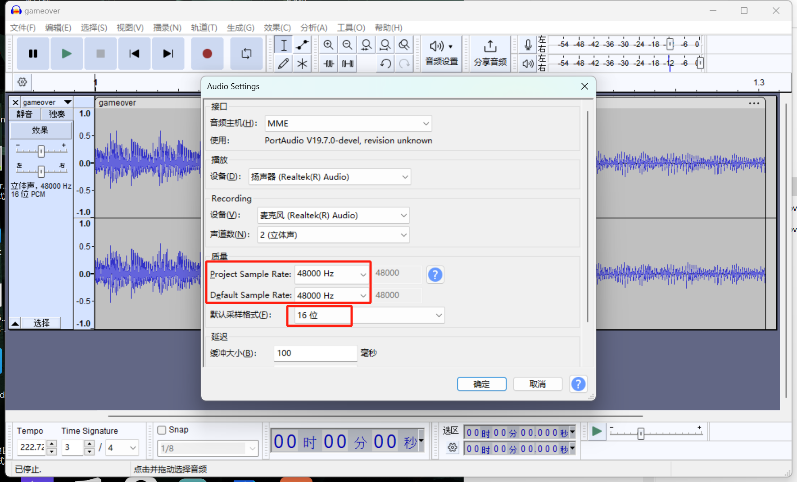

Cut And Config the Music We Need
Audacity
Notes:
Next, I will explain the code integration and the debug section. First of all, during the process of adjusting the pingpong code to the LCD code, due to the incorrect number of parameters in the LT24, there are many errors that are incorrectly caused by the related driver code update (as shown in the figure below). In the analysis and discussion found in this year‘s update, the LT24 update is mainly to add the context of the data structure LT24CTX_T (as follows). The purpose is to put the LT24 control status and data in the structure. Therefore, the entire LT24 driver can be achieved. More fluent and clear！

Slide 27
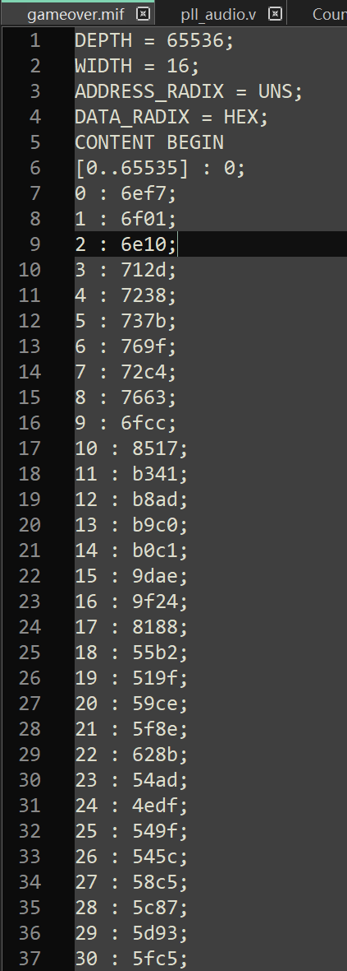
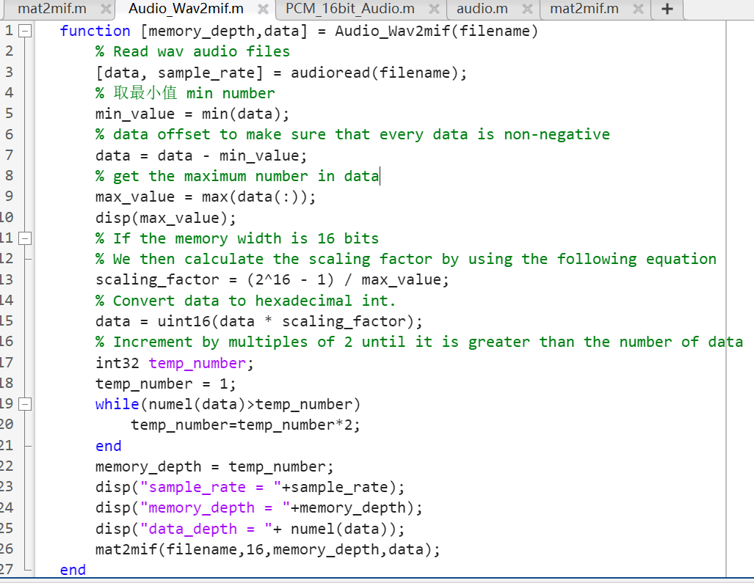
Generate Mif File
Notes:
Next, I will explain the code integration and the debug section. First of all, during the process of adjusting the pingpong code to the LCD code, due to the incorrect number of parameters in the LT24, there are many errors that are incorrectly caused by the related driver code update (as shown in the figure below). In the analysis and discussion found in this year‘s update, the LT24 update is mainly to add the context of the data structure LT24CTX_T (as follows). The purpose is to put the LT24 control status and data in the structure. Therefore, the entire LT24 driver can be achieved. More fluent and clear！

Slide 28
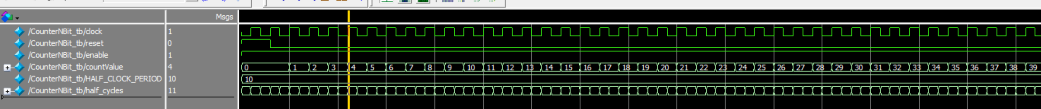
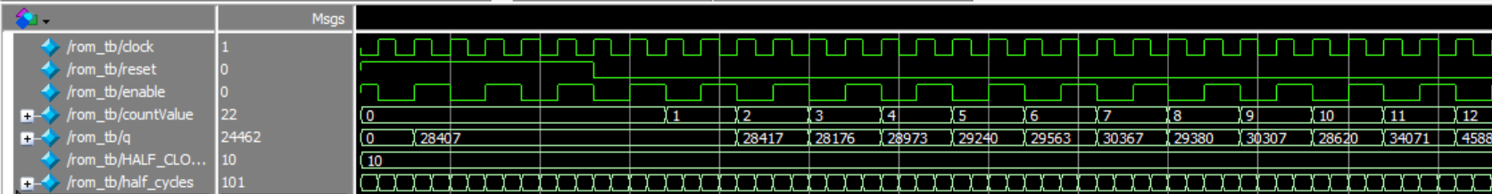
Mif Data Reading Related Testbench
Testbench of CounterNBit.v
Testbench of test_rom.v
Notes:
It was also discovered while porting that you cannot simply pass the address directly as a parameter, but rather you have to pass it with a pointer that represents the address so that you can accurately use the LT24's display driver

Slide 29
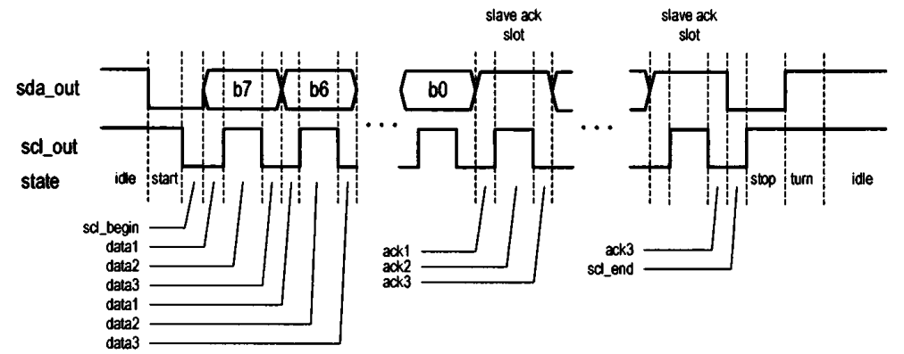
State Machine Settings For IIC
Notes:
After dealing with the problem of mismatched parameter numbers caused by the update of LT24's driver, we compiled and burned the code into the development board, we could see that we successfully entered the cover and entered the game, but the cover did not disappear with the start of the game and the pingpong ball kept blackening the background in the process of movement. Later, we learnt that the student in charge of the pingpong game had set the background to black by default, so that every time the paddle and the ball moved, the previous area would be blacked out, so we chose to change the background back to black
After fixing the background, we noticed that the movement of the ball also blacked out the text (as shown in the video below), so we chose to remove the text.
After dealing with the above problem, I found another problem with the scoreboard displaying abnormally, and after careful analysis, I found that it was the scoreboard changing without effectively clearing the previous number.
After solving the above problems, I found that I can finally play the game normally, the next step is to add the corresponding background image and adapt the game2

Slide 30
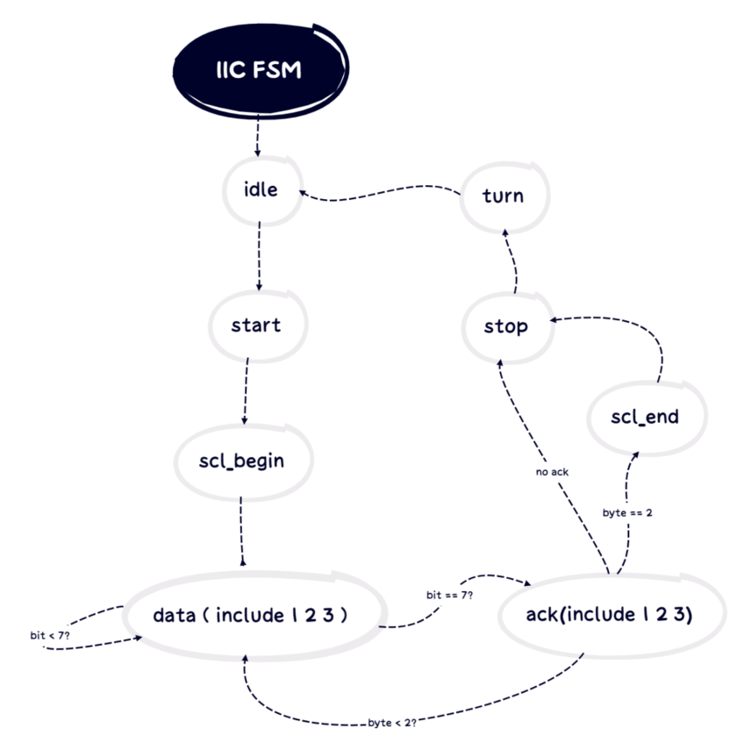
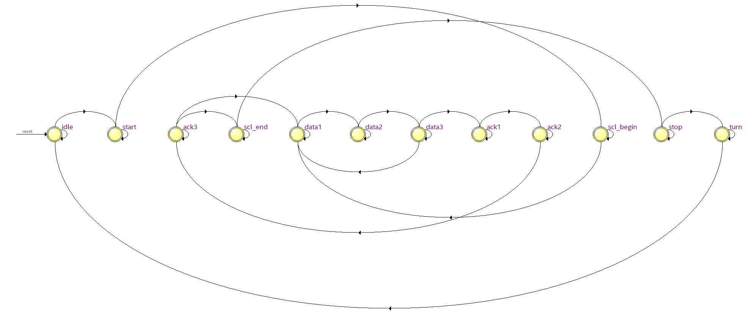
State Machine Settings For IIC
2 bytes = 7-bit register ID + 9-bit register data value
Notes:
After merging the game2 code and adding the new pingpong game cover, the LCD code was also updated, but since the LCD code puts all the displays in the framebuffer, it slows down the game, as shown in the following video:
After informing the relevant LCD students to modify the code, the problem was successfully solved, the game speed back to normal, basically debugging is complete, but the game button due to interruptions can not be recognised as a long time to press the state, which leads to the ping-pong paddle can only be moved one by one press. The following video shows: After processing the interrupt key detection and ping pong paddle key detection separately, the continuous movement of the ping pong paddle was finally achieved and the game failure screen was successfully displayed as shown in the video below:
After processing the interrupt key detection and ping pong paddle key detection separately, the continuous movement of the ping pong paddle was finally achieved and the game failure screen was successfully displayed as shown in the video below

Slide 31
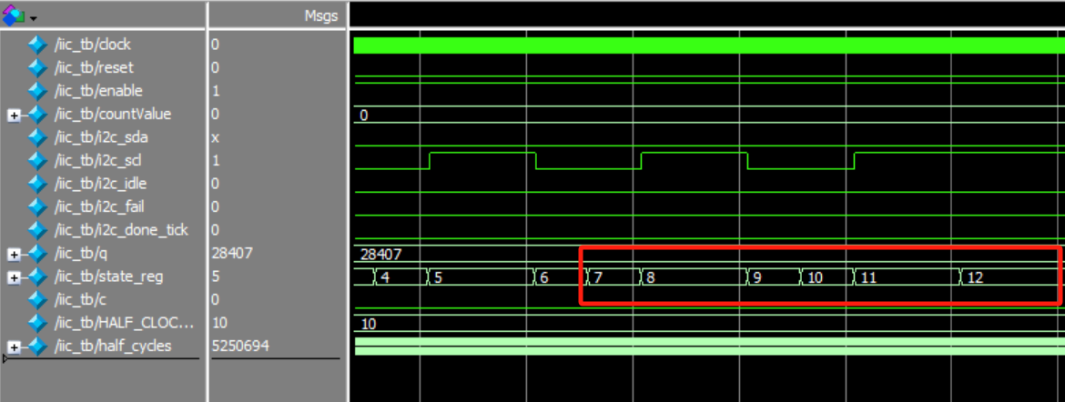
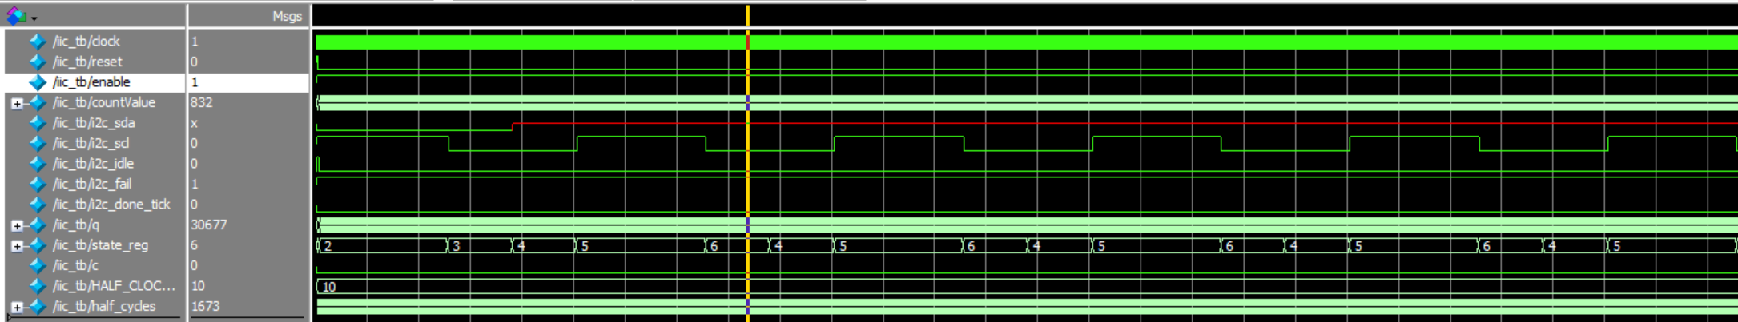
IIC Related Testbench
start->scl-begin->data1->data2->data3
Ack1->ack2->ack3->scl_end->stop->turn
Notes:
After merging the game2 code and adding the new pingpong game cover, the LCD code was also updated, but since the LCD code puts all the displays in the framebuffer, it slows down the game, as shown in the following video:
After informing the relevant LCD students to modify the code, the problem was successfully solved, the game speed back to normal, basically debugging is complete, but the game button due to interruptions can not be recognised as a long time to press the state, which leads to the ping-pong paddle can only be moved one by one press. The following video shows: After processing the interrupt key detection and ping pong paddle key detection separately, the continuous movement of the ping pong paddle was finally achieved and the game failure screen was successfully displayed as shown in the video below:
After processing the interrupt key detection and ping pong paddle key detection separately, the continuous movement of the ping pong paddle was finally achieved and the game failure screen was successfully displayed as shown in the video below

Slide 32
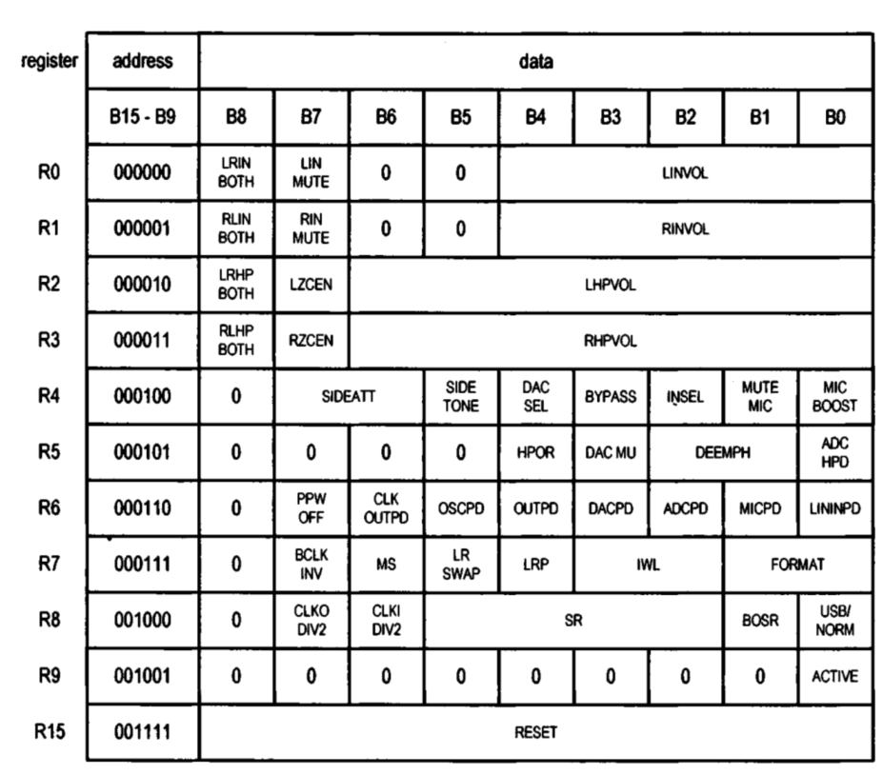
Config WM8731 Through IIC
R0 & R1: Mute and Gain
R2 & R3: Volume and zero-crossing detection circuit
R4: ADC/DAC/Microphone input modes and microphone related operations
R5 : DAC and ADC filter related configuration
R6: Power saving mode for each part
R7 & R8: Set the digital audio interface and sampling rate:

Slide 33
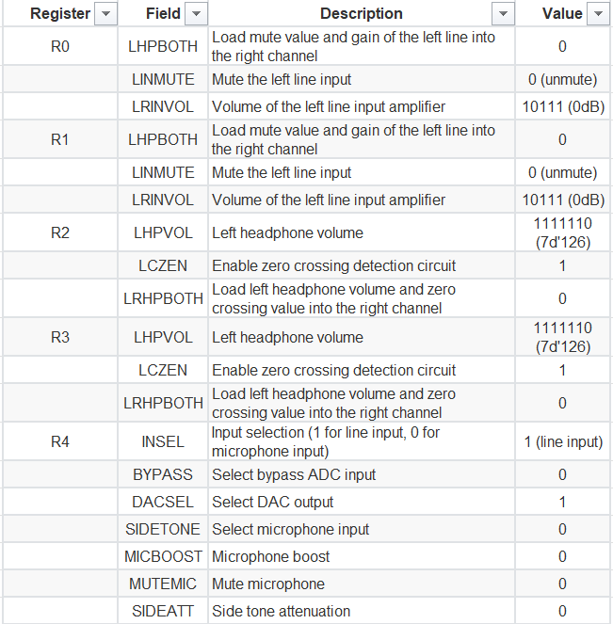
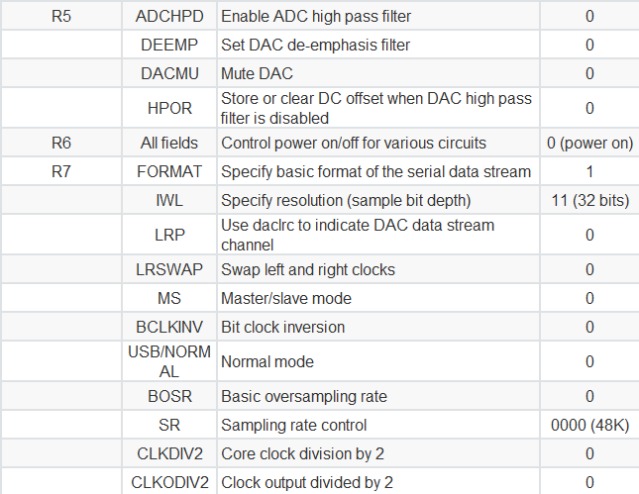
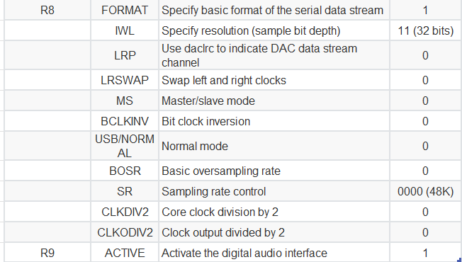
Config WM8731 Through IIC

Slide 34
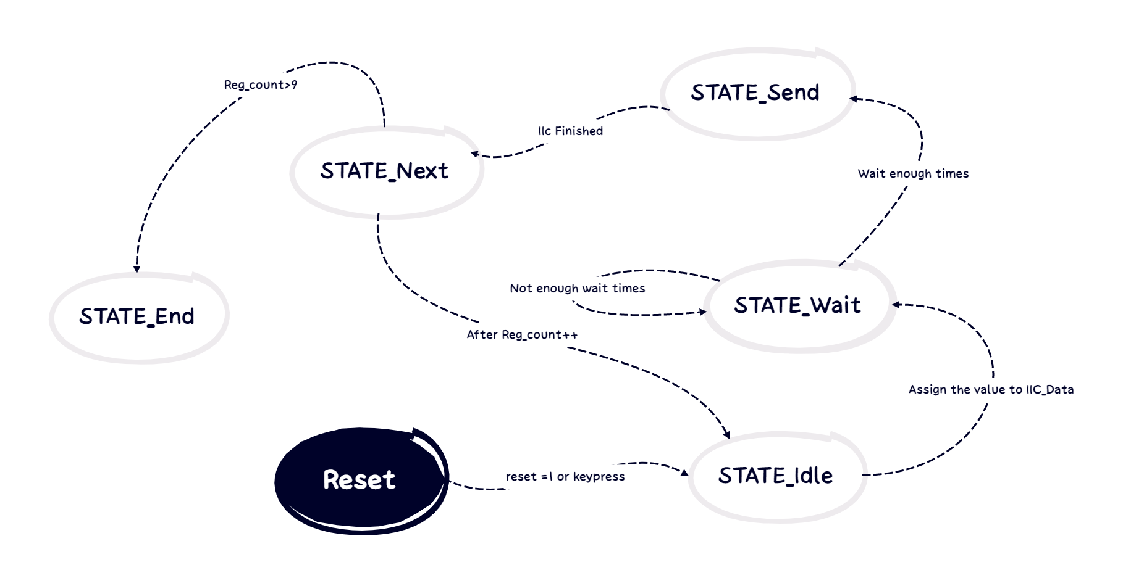
FSM About Config WM8731 Through IIC

Slide 35
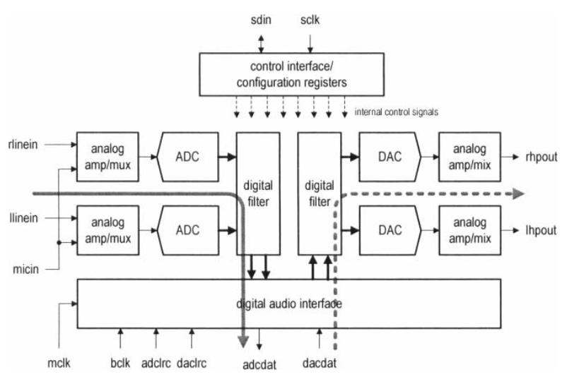
IIS Data Transmission Part

Slide 36
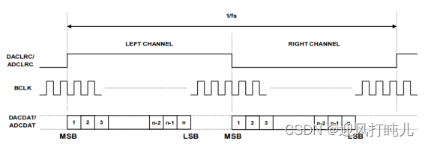
IIS Data Transmission Part

Slide 37
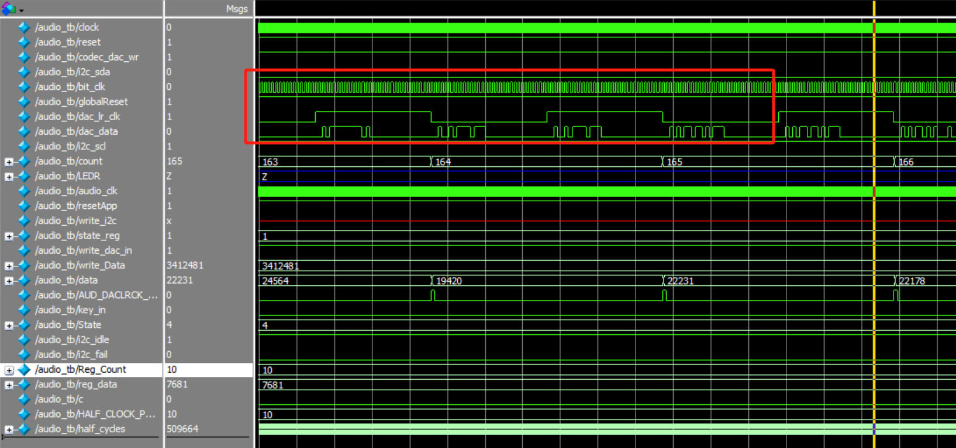
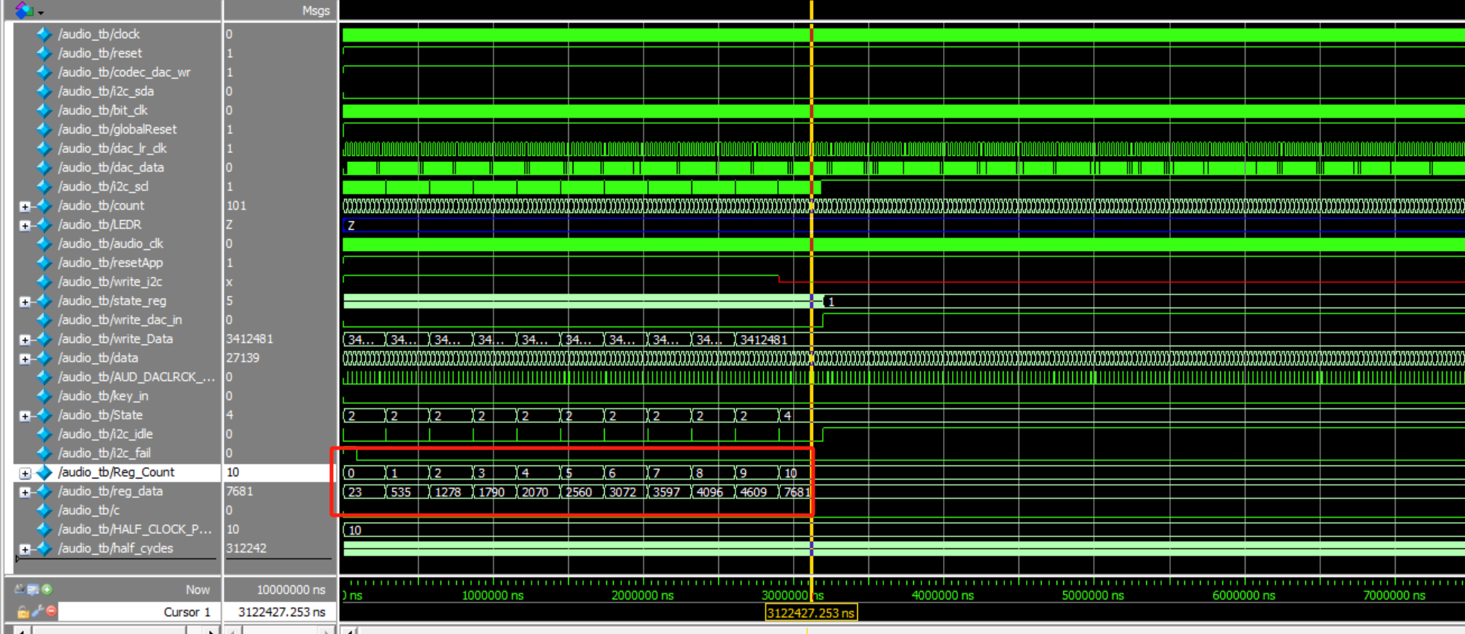
IIS Data Transmission Part

Slide 38





Pin Set For Audio Part

Slide 39

Audio Display

Slide 40

Conclusion
The aim of the project was partly achieved.
Make use of seven segment display and Switches for inputs.
IP Core and Hierarchical design used.
LCD Display and the priority of them
Multiple State Machines used in:
IIC driver code (iic_driver.v)
Config WM8731 (codec_top.v)
Self-verifying testbenches for each file, Reuse of IP developed in module in LCD display.
Make use of WM8731 on the DE1-SoC.

Slide 41

REFERENCES
《Embedded SoPC design with NIOS II processor and Verilog Examples》
ELEC5566M-Resources\sampleCode\Unit3-2\mat2mif.m
ELEC5566M LT24 Display Driver
ELEC5566M UNIT 1-2 7-segment
ELEC5566M UNIT 2-1 CounterNBit
ELEC5566M UNIT 3-1 ResetSynchroniser
ELEC5566M UNIT 3-2 IP Cores (ROM)
AhmadGon/WM8731-Audio-CODEC: WM8731 Audio CODEC using Verilog (DE2-115) (github.com)
ffxx283/WM8731_Audio: FPGA Control WM8731 Audio codec (github.com)

Slide 42

REFERENCES
- [FPGA Configuration Collection WM8731 Novice Application Notes-CSDN Blog]
- [FPGA Driver WM8731 Audio Transceiver Full Network Most Detailed Explanation Provide 2 Sets of Engineering Source Code and Technical Support_vm8731-CSDN Blog](https://blog.csdn.net/qq_41667729/article/details/130668537)
- [FPGA Operation WM8731 Audio Codec Slave Mode, Novice Self-Critique-CSDN Blog](https://blog.csdn.net/qq_41667729/article/details/120953453)
- "Embedded SoPC design with NIOS II processor and Verilog Examples"
- "DE1-SoC_User_Manual"
- "WM8731_Audio_Codec_Datasheet"
- [Explore Arrow SoCKit Part VIII - Audio Codec --- Exploring the Arrow SoCKit Part VIII - The Audio Codec (zhehaomao.com)]

Slide 43

Thank You!

